Slide 1
My week in JavaScript Hell
So you don’t have to go through it
@keerthanak17
Notes:
<number>

Slide 2
Disclaimer
@keerthanak17

Slide 3
Professionally, I work at
@keerthanak17

Slide 4
Software Engineer/ Web Developer/ Front End / JS Connoisseur/ ??
What the hell am I doing?
@keerthanak17

Slide 5
1 year – 2 languages – 2 frameworks – 5+ libraries -++
AKA - What the hell am I doing?
@keerthanak17

Slide 6
I retained NOTHING properly
I am very confused ☹
@keerthanak17

Slide 7
Back to Basics – Vanilla JS
I need some answers
@keerthanak17

Slide 8
Hello JavaScript!
Open – ECMAScript 2017
De-facto standard for scripting on the web
Dynamic, weakly typed
Beginner friendly
@keerthanak17

Slide 9
The problem with making something too easy
Easier to build bad habits
@keerthanak17

Slide 10
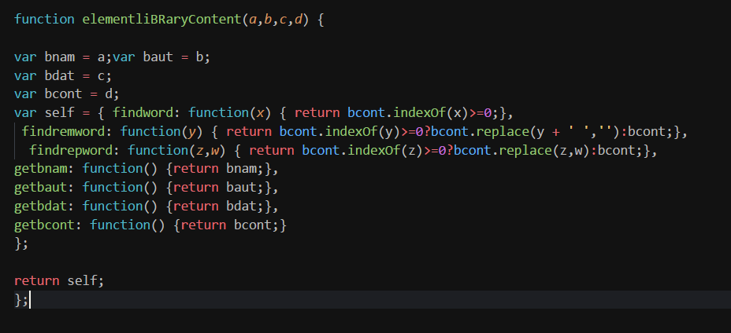
Code style - adhoc

Slide 11
Some terrible practices
Global variables
Repeated code
Edge conditions
Improper formats
…
@keerthanak17

Slide 12
Solution : Functional JS
Making JS more structured
@keerthanak17

Slide 13
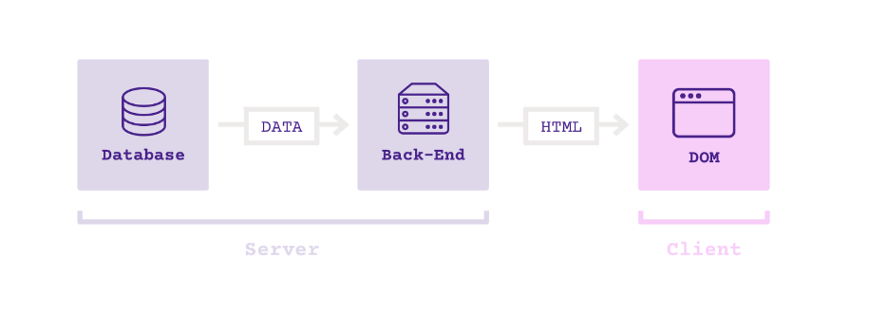
Traditional web app : circa 2008
Image source : unknown
@keerthanak17

Slide 14
New age web app : 2015+
Image source : unknown
@keerthanak17

Slide 15
The important question : WHY??
It’s modular
It’s reusable
There’s abstraction
Data >> Methods
@keerthanak17

Slide 16
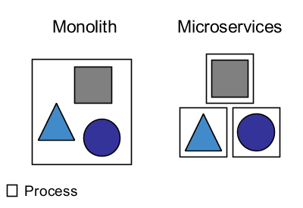
A shift in trends
@keerthanak17
Image source : blog.philipphauer.de

Slide 17
To handle more stuff in the front!
Single Page Applications
Gifs and Animations
Faster loading
More stuff on the front end
@keerthanak17

Slide 18
A helping hand: Frameworks/Libraries
Decrease coding time
Built by wiser people
Adds functionality
Efficiency
+++
@keerthanak17

Slide 19
So what’s a dev gotta do?
We gotta tough job now
@keerthanak17

Slide 20
Ask the WH Questions
What? Why? How?
What is a Progressive Web App?
How do you improve the performance of your site?
Why use CSS Grid?
@keerthanak17

Slide 21
Collect some metadata
Why should you select React/Angular/Vue?
What’s their best feature?
How do the improve performance?
How does it implement binding?
@keerthanak17

Slide 22
ASK People!
Your software lead
Your peers
Your mentors
Your manager
A random person
@keerthanak17

Slide 23
Do not avoid a topic!
It might make your life easier!
@keerthanak17

Slide 24
Own up to your failure
And fix it!
Ask for improvement
Follow through on it
@keerthanak17

Slide 25
Always, Always, Always: Follow up
No matter what
@keerthanak17

Slide 26
Beware of the mistake avalanche!
The what now?
@keerthanak17

Slide 27
So, in summary
There’s no single way to learn/ use JS
Never forget: Vanilla JS is powerful
Keep (re)freshing your basics/ knowledge
@keerthanak17

Slide 28
And most importantly,
Ask the WH questions about everything
Fail fast – Fix it – Move on!
@keerthanak17

Slide 29
Q&A time!
Anything to ask?
@keerthanak17

Slide 30
That’s all folks!
Thanks a lot! ☺
@keerthanak17

